Slide 1
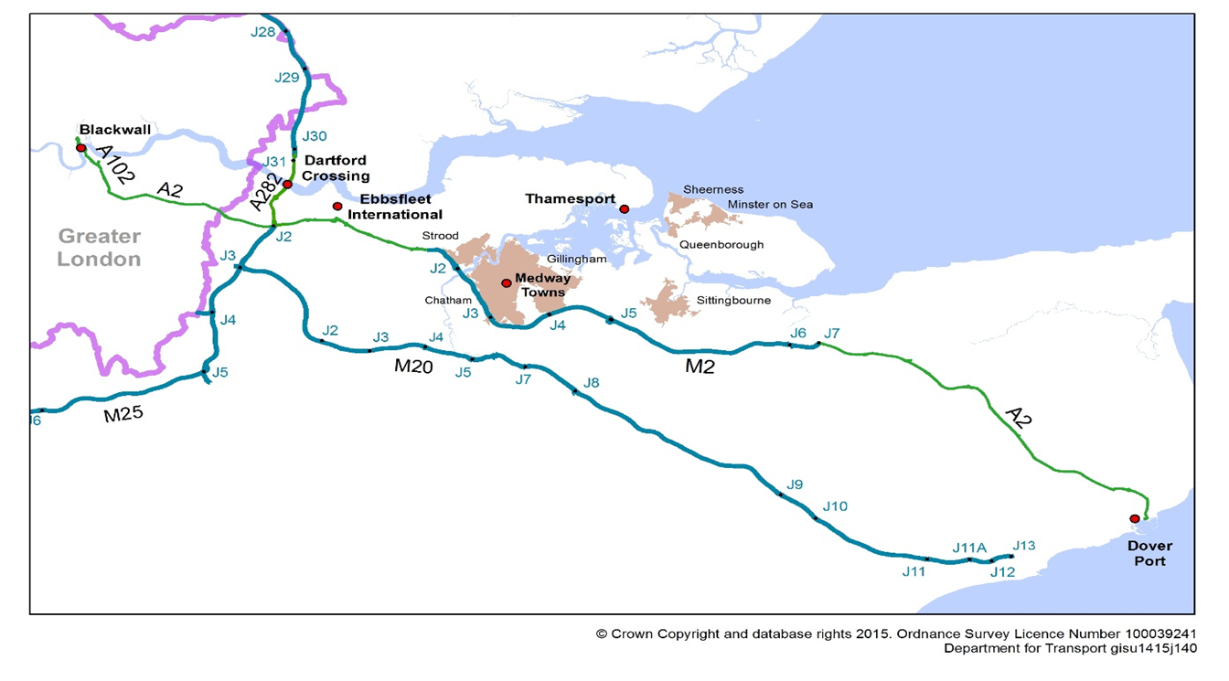

Kent

Slide 2
Why Participate
Congestion Management Programme
  Traveller information
  Road safety
Impacts of the Channel on the County
Freight
  Operation Stack
  Lorry parking
  Dartford Crossing

Slide 3
Future Development
Strategic Corridors
Air Quality Pressures
Logistics
Lorry Parking Management
Port Management
Dartford Crossing

